Slide 1
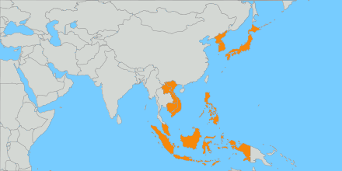
Team 9: Alessandro, Baturalp, Honglin, Javed, Linh, Luciana
Data Analysis: East/Southeast Asia
Notes:
ALE
Data Source: WDI_Metadata.xlsx
Year: 2017
Tools: Python, Ms Excel

Slide 2
Methodology
01
02
03
04
Researched for missing data
Handled missing data
Defined outliers
Analyzed outliers
Conducted exploratory data analysis
Correlation
Extensive secondary research
Insights
Conclusion
Notes:
ALE
For missing values, we divided columns with more than and less than 4 missing. We just erased the columns with more than 4 values and did accurate research on why those values where missing, for each country. For columns with less than 4 values missing, we flagged them according to the distribution. If the distribution tends to be normal, we use mean, otherwise we use median.

Slide 3




Methodology – Missing values
Coded loop to check for the percentage of missing values in each column ​
​
Condition to add values or erase the column if % is lower or higher than 40%​
Eventually replaced the value whether we could find it in a reliable source​
Manually checked and compared any eventual added value
Notes:
ALE
For missing values, we divided columns with more than and less than 4 missing. We just erased the columns with more than 4 values and did accurate research on why those values where missing, for each country. For columns with less than 4 values missing, we flagged them according to the distribution. If the distribution tends to be normal, we use mean, otherwise we use median.​
​

Slide 4
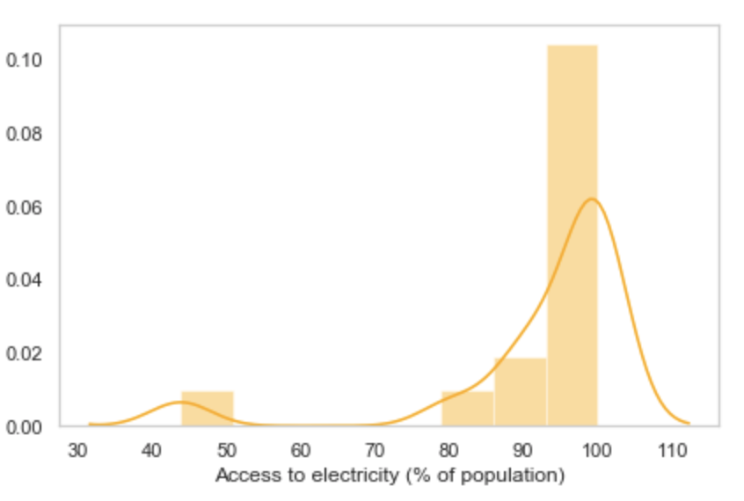
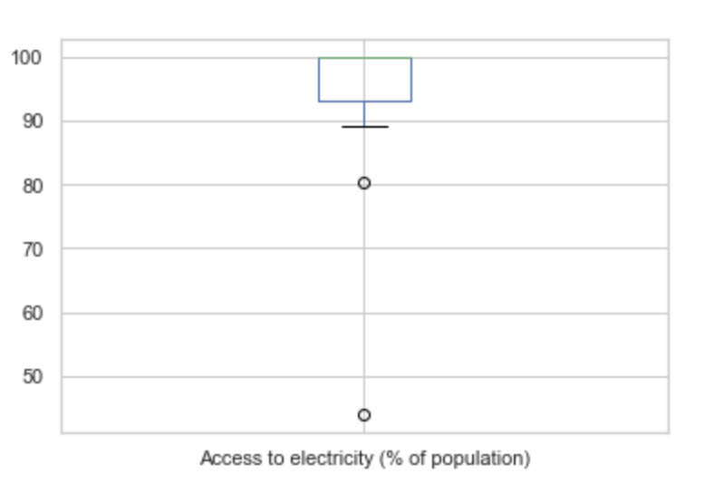
Methodology - Outliers
Visualized variables with histogram in loop
Visualized boxplots for each variable for the region
Outliers highlighted and identified
East Timor
North Korea
Notes:
ALE

Slide 5




Missing values
Secretive nature of dictatorial North Korean government (economic activity unknown)
Hong Kong and Macau's military belong to China
South Korea and Brunei: HIV is highly stigmatized
Inconsistent years making for poor-quality data
Notes:
LINH
With regards to missing values, we found many for North Korea, especially related to its economic activity. This is a result of the secretive nature of the North Korean government, being an isolated, communist society.
Data related to Hong Kong and Macau's military personnel was also unavailable, and after further research and primary interviews, we discovered that this is because Hong Kong and Macau’s military belong to China and are thus included in China’s military data, which is not part of our region. The Chinese government restrict these countries from having their own military. As well, previously, the Hong Kong military was part of Britain, and the Macau military was part of Portugal’s due to them being colonies of these two countries respectively.
There were several countries also missing data on the prevalence of HIV. Although one of these countries was North Korea, which claims to be free of HIV, we found that in some of these countries, including South Korea and Brunei, there is extreme stigma, neglect, and discrimination towards those with HIV. For example, patients can be disowned by families, thrown out of hospitals, and refused non-HIV related care if they're revealed to be HIV+, causing many to fear testing. Foreigners could even be deported if they are HIV+.
Although data about the education in the different countries would have been very valuable, UNESCO states a lack of data that vary and that are inconsistent.
As well, complete enrolment information hasn’t been collected in some countries often due to poor statistical information systems, or emergencies such as armed conflict or natural disasters. When the the Global Monitoring Report tried to increase the country coverage and bridge the data gap, it identified 35 countries or territories with insufficient or no data for core indicators and to measure progress. Among these countries in our region are: North Korea, Macao, the Philippines, and Singapore.
For other columns of missing data, for example porverty headcount ratios, we did find the data on World Bank and other sources, but the years were inconsistent, ranging as much as 17 years. These measures could therefore not be compared because it doesn't accurately represent the full picture, and would make for poor-quality, inaccurate data and analysis. As well, many countries may not report on these data indicators consistently; there could also be lost data during the data processing and merging, due to the techniques used.

Slide 6


Countries of interest
East Timor
Hong Kong
GDP growth = -9.15%
Population ages 0-14 = 38.3%
Merchandise trade = 333.73% of GDP
Industry = 7.2% of GDP
Notes:
LUCIANA
EAST TIMOR: GDP growth (annual %) x Population ages 0-14 (% of total population): The GDP growth (which is negative 9.15) is probably due to the percentage of children in the population (38.3%). They cannot work, at least legally, and if they do work taxes are not collected and that would reflect on the GDP as well. Also “Oil production is ceasing, leaving a fiscal deficit and a depleting sovereign wealth fund”.
Hong Kong: Industry (including construction), value added (% of GDP) x Merchandise trade (% of GDP): Merchandise from China mainland is coming to Hong Kong and being exported to the rest of the world, that’s why the Merchandise Trade is 333.73% of the GDP.

Slide 7


Countries of interest
Laos
Japan
Employment in agriculture ≈ 70%
Agriculture, forestry, and fishing ≈ 17% of GDP
Birth rate = 7.6 (per 1.000 people)
Population growth = -0.16% (annual)
Life expectancy at birth = 84.1 years
Notes:
LUCIANA
LAOS: while employment in agriculture is around 70%, agriculture, forestry and fishing compose around 17% of the GDP, which probably shows that the country is not focusing in quality products, only in quantity. They should explore and use more technology in agricultural to lower costs and make agriculture, etc more profitable.
Japan: Birth rate is very low and Japonese are having less kids, which shows by the negative population growth. That is a big problem since the population's life expectancy is high, with 84 years old. Who will sustain the oldest if there's no kids that will be the future workforce?
Birth Rate = 7.6 (per 1.000 people)
Population growth = -0.16% (Annual)
Life expectancy at birth, total = 84.1 (years)

Slide 8
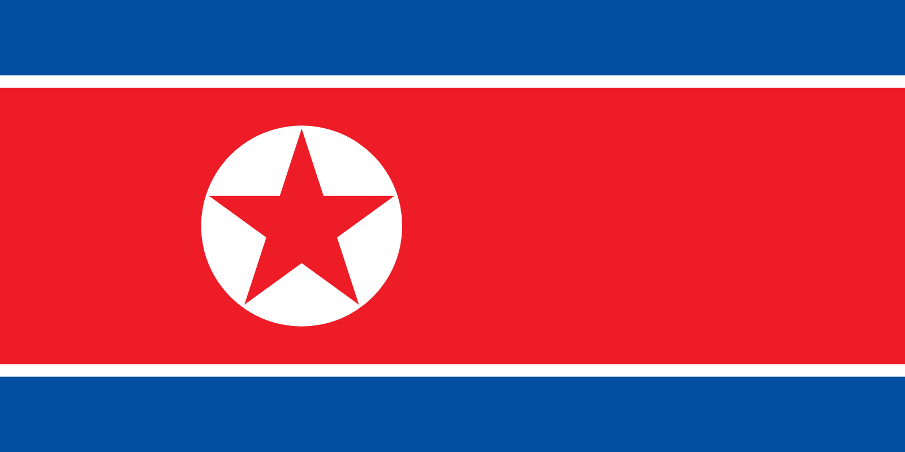




North Korea
Access to electricity =
43.9% of population
Rural = 52.7%
Urban = 38.6%
Employment in agriculture =
59.94% of total employment
Armed forces personnel = 9.01%​ of total labor force
Prevalence of undernourishment =
47.8% of population
Notes:
LUCIANA
On this slide we're going to talk a little about North Korea, which had a lot of outliers.
For example, only 43, 9% of the population from North Korea has no access to electricity. The few sources of electricity are mostly used for military and industry use.
As we can see also, around 9% of the population is part of the armed forces and around 60% are employed by agriculture.
Unfortunately we see that around 48% of the population is undernourished.

Slide 9

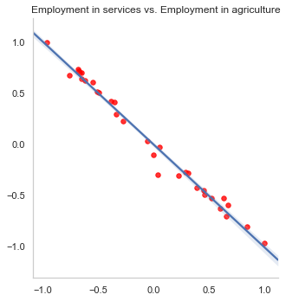
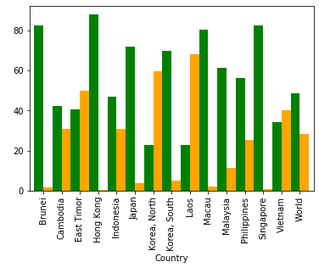
Services vs. Agriculture within region
Notes:
BATU

Slide 10
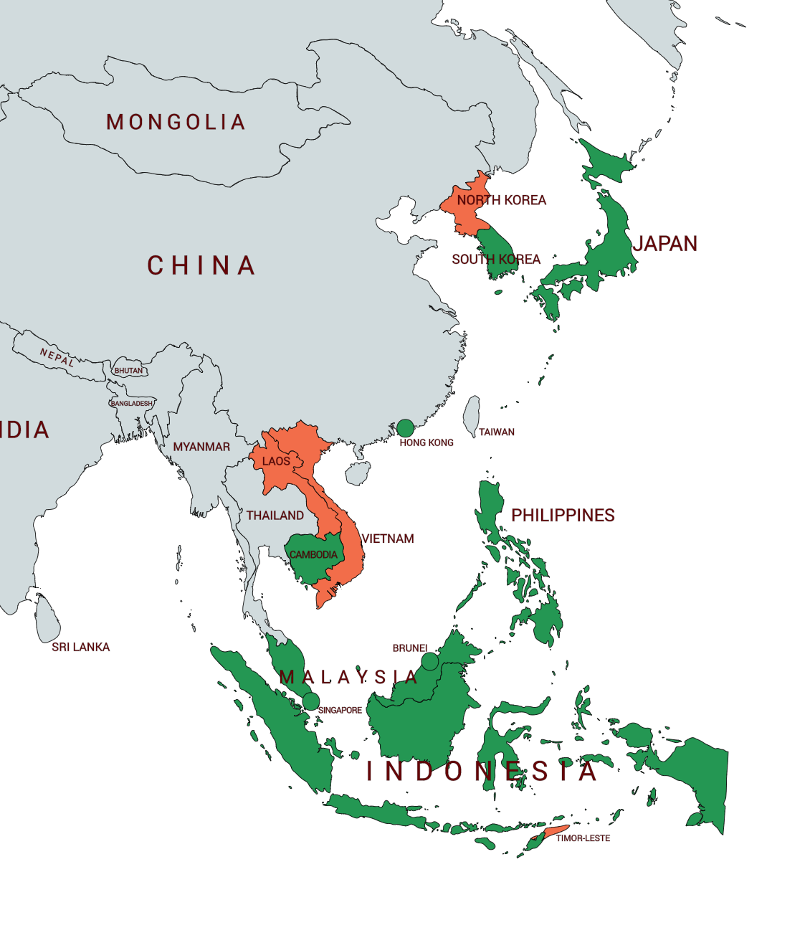
Green = Services economy
Orange = Agriculture economy
Breakdown of economies within region
Notes:
BATU

Slide 11
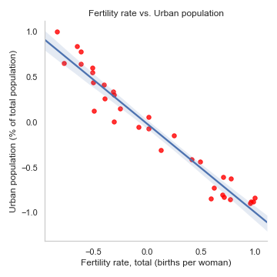
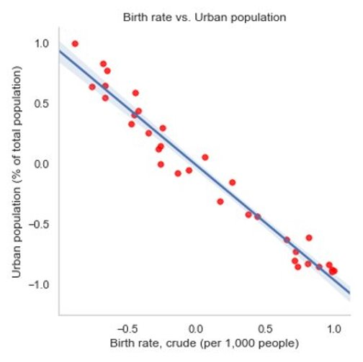
Correlation analysis
Notes:
LINH
After plotting both fertility rate and birth rate against the urban population of the countries in the region, we found that both had an inverse relationship. So, the higher the urban population for the country, the lower the fertility and birth rates. We found this interesting, so we did further research on it, and came across multiple sources that confirmed this correlation. Evidence gathered indicates that fertility declines as a country's population becomes more urban, and that urban women use contraception more than rural women.
Several other theories exist in literature, including selective migration which talks about how couples with childbearing intentions may decide to move to smaller places that are better to raise children while those with no plans to have children may move to more urban areas. As well, in urban areas, the desired family size is smaller and the cost of living (and thus raising a family) is generally higher.
From a traditional standpoint, fertility was high in rural, agricultural societies to provide needed labour and to offset high mortality.
https://hal.archives-ouvertes.fr/hal-00714930/document
https://pubs.iied.org/pdfs/10653IIED.pdf

Slide 12
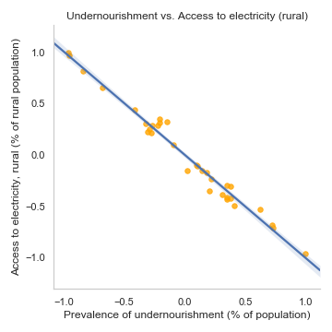
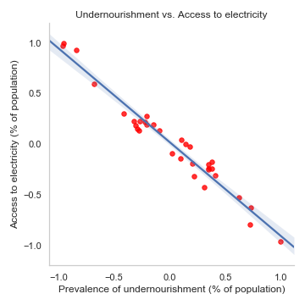
Correlation analysis
Notes:
LINH
We also found a strong correlation between undernourishment and access to electricity, as can be shown by these regressions. As the access to electricity decreased, the prevalence of undernourishment increased among these countries. This made sense, but we wanted to find external sources to back up this correlation and our hypotheses as to why this was the case.
According to the Food and Agriculture Organization of the United Nations, in developing countries, food is lost due to infrastructural constraints including lack of access to modern energy to drive improved food processing technologies, and to optimize storing facilities. Without proper storing infrastructure or refrigeration, livestock products, fish, fruits and vegetables can easily spoil. A large proportion of fresh products are spoiled due to the lack of cooling, drying and technologies that would enable safe storage.
Lack of electricity can also affect cooking practices and dietary choices according to the International Energy Agency (IEA). This can result in reduced cooking times, skipping meals, and switching to foods that are less fuel-demanding. Many of the main food crops in developing countries such as some of the ones in our region are not appetizing or fully-digestible unless cooked, and foods like beans, which are highly nutritious, are more fuel-demanding. So, protein intake can be lowered when alternative faster-cooking foods are chosen, which leads to poorer nutritional balance.
http://www.fao.org/3/a-i6626e.pdf
https://link.springer.com/article/10.1007/s12571-016-0570-1

Slide 13


Conclusion - Insights
East Timor
Improved infrastructure to sustain population growth and support families
Japan
Incentivize citizens to have children to stimulate population growth and even out population
Notes:
LINH
- East Timor's population is growing, and a large proportion of this is ages 0-14 whom are highly-dependent on the working class. Due to this, improved infrastructure is needed through higher investments
- Meanwhile, Japan's population is getting older, and the elderly are highly-dependent on the working class. Their population is also decreasing due to the death rate outweighing the birth rate. Maybe the government should incentivize citizens to have children, for example by giving them tax deductions. As well, increase acceptance of immigrants.
Birth rate and fertility rate: East Timor
Death rate: Japan
GDP growth: Highest = Macau, Lowest = East Timor (the only negative one)
Population growth: Higher = East Timor, Lowest = Japan (the only negative one)

Slide 14
Thank you!
Data Analysis: East/Southeast Asia
Notes:
ALE
Data Source: WDI_Metadata.xlsx
Year: 2017
Tools: Python, Ms Excel

Slide 15
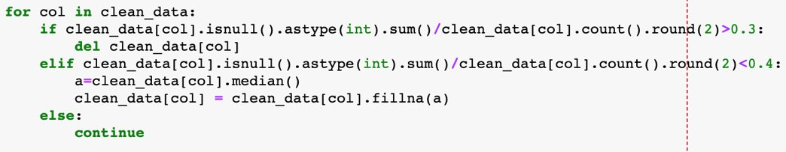
Appendix: for loop
For loop used to handle missing values
Notes:
- East Timor's population is growing, and a large proportion of this is ages 0-14 whom are highly-dependent on the working class. Due to this, improved infrastructure is needed through higher investments
- Meanwhile, Japan's population is getting older, and the elderly are highly-dependent on the working class. Their population is also decreasing due to the death rate outweighing the birth rate. Maybe the government should incentivize citizens to have children, for example by giving them tax deductions. As well, increase acceptance of immigrants.

Slide 16
References
https://pubs.iied.org/pdfs/10653IIED.pdf
https://www.ncbi.nlm.nih.gov/pubmed/12339316
https://www.worldbank.org/en/country/timor-leste/publication/april-2017-timor-leste-economic-update
https://news.fx168.com/opinion/column/hujiajun/1908/3278887.shtml
https://www.nationalreview.com/2018/06/north-korean-regime-limits-access-to-electricity-to-keep-power/
https://www.cnbc.com/2019/04/11/kim-jong-un-pursues-this-energy-strategy-to-keep-north-korea-afloat.html
https://tradingeconomics.com/brunei/urban-population-percent-of-total-wb-data.html
https://www.worldometers.info/world-population/timor-leste-population/
https://www.un.org/development/desa/dpad/wp-content/uploads/sites/45/CDP-PL-2018-6f.pdf
https://ourworldindata.org/financing-education
https://www.worldometers.info/world-population/brunei-darussalam-population/
https://www.indexmundi.com/facts/lao-pdr/indicator/MS.MIL.XPND.GD.ZS
https://tradingeconomics.com/laos/military-expenditure
https://www.thejakartapost.com/news/2018/01/04/govt-to-strive-for-poverty-rate-below-10-percent.html
https://opinion.inquirer.net/110407/poverty-rose-slightly-2017#ixzz63sP8EfWF
https://e.vnexpress.net/news/news/9-million-vietnamese-people-still-living-in-extreme-poverty-report-3733087.html
https://www.indexmundi.com/facts/indicators/SI.DST.04TH.20/rankings
https://www.investopedia.com/articles/investing/013015/how-north-korea-economy-works.asp
https://www.japantimes.co.jp/news/2019/02/22/asia-pacific/even-help-spies-satellites-analyzing-north-koreas-economy-isnt-easy/#.Xbi2GEVKiTc
https://www.ceicdata.com/en/indicator/brunei/tax-revenue
https://www.pwc.com/gx/en/tax/corporate-tax/worldwide-tax-summaries/pwc-worldwide-tax-summaries-corporate-taxes-2017-18.pdf
https://www.pwc.com/gx/en/tax/corporate-tax/worldwide-tax-summaries/pwc-worldwide-tax-summaries-corporate-taxes-2017-18.pdf)
https://books.google.com/books?id=1F6BAgAAQBAJ&pg=PA214&lpg=PA214&dq=why+is+there+no+data+on+undernourishment+in+singapore&source=bl&ots=PswIOvqICG&sig=ACfU3U0AYBj_xgRxkZc3pKbKSKzDC5XtGw&hl=en&sa=X&ved=2ahUKEwjZsKfg5L_lAhXO854KHXt-B5AQ6AEwEXoECAgQAQ
https://www.indexmundi.com/facts/indicators/nv.agr.totl.zs/map/asia

Slide 17
References cnt’d
http://www.nsitaxlaw.com/files/AseanTax-Brunei.pdf
https://www2.deloitte.com/content/dam/Deloitte/cn/Documents/international-business-support/deloitte-cn-ibs-brunei-int-tax-en-2017.pdf
https://www.scmp.com/news/hong-kong/hong-kong-economy/article/3008601/record-hk3414-billion-tax-revenue-hong-kong-tops
https://www.ird.gov.hk/eng/abo/rev.htm
https://www.ceicdata.com/en/indicator/hong-kong/tax-revenue
https://tradingeconomics.com/laos/tax-revenue-percent-of-gdp-wb-data.html
https://en.unesco.org/gem-report/sites/gem-report/files/Countries%20with%20incomplete%20or%20missing%20data.pdf
https://www.thirdway.org/report/how-higher-education-data-reporting-is-both-burdensome-and-inadequate
https://www.chronicle.com/blogs/data/2015/05/04/attainment-completion-and-the-trouble-in-measuring-them-both/
https://www.basiclaw.gov.hk/tc/basiclawtext/index.html
https://www.forbes.com/sites/kellyphillipserb/2018/06/12/a-quick-look-at-north-korea-from-history-to-taxes/#6a37b9e744c5)
https://books.google.com/books?id=1F6BAgAAQBAJ&pg=PA214&lpg=PA214&dq=why+is+there+no+data+on+undernourishment+in+singapore&source=bl&ots=PswIOvqICG&sig=ACfU3U0AYBj_xgRxkZc3pKbKSKzDC5XtGw&hl=en&sa=X&ved=2ahUKEwjZsKfg5L_lAhXO854KHXt-B5AQ6AEwEXoECAgQAQ
http://www.fao.org/3/a-at702e.pdf
https://www.straitstimes.com/singapore/new-centre-in-singapore-to-conduct-asias-largest-study-on-undernutrition-among-the-elderly
https://www.aids.gov.hk/english/surveillance/sur_report/hiv_fc2017e.pdf
https://www.unaids.org/en/regionscountries/countries/bruneidarussalam
https://www.aidsdatahub.org/old/Country-Profiles/Brunei-Darussalam
http://hivtravel.org/Default.aspx?PageId=143&CountryId=4
https://thescoop.co/2018/12/03/increasing-rate-of-hiv-contraction-in-brunei/
http://hivtravel.org/Default.aspx?PageId=143&CountryId=4
http://www.hivpolicy.org/Library/HPP000476.pdf
https://www.scmp.com/news/hong-kong/health-environment/article/2095006/hiv-cases-hong-kong-hit-record-high-more-younger
https://www.sciencemag.org/news/2019/06/exclusive-north-korea-claimed-be-free-hiv-infections-appear-be-surging
https://link.springer.com/article/10.1007/s12571-016-0570-1
http://www.fao.org/3/a-i6626e.pdf
https://uwaterloo.ca/waterloo-research-institute-in-insurance-securities-and-quantitative-finance/sites/ca.waterloo-research-institute-in-insurance-securities-and-quantitative-finance/files/uploads/files/03-02.pdf

